Slide 1
HealthInsured
Customers Growth and Churn Customers Report

Slide 2
Product Growth & Churn Report

Slide 3
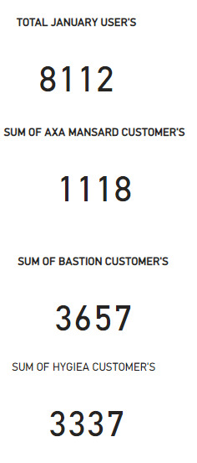
JANUARY PRODUCT PERFORMANCE
HMO | ACTIVE | %ACTIVE | INACTIVE | %INACTIVE | TOTAL
Axa Mansard | 975 | 12.02% | 143 | 1.76% | 1118
Bastion | 3347 | 41.26% | 310 | 3.82% | 3657
Hygiea | 1495 | 18.43% | 1842 | 22.71% | 3337
Total | 5817 | 71.71% | 2295 | 28.29% | 8112

Slide 4
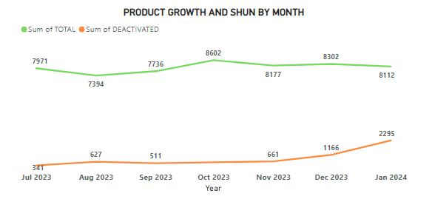
January, 2024 Product Growth and Churn Report
Product Growth & Churn By Month
In this analysis , there are 8112 total product users, which 5817 (71.71% ) of them are Active and 2295(28.29%) of the users are Inactive. Bastion has the highest product users of 3347(41.26%), while Hygiea has the highest number of Deactivated product users of 1842(22.71%)
The Chart above shows the product growth and Churn, from July 2023 to January 2024

Slide 5
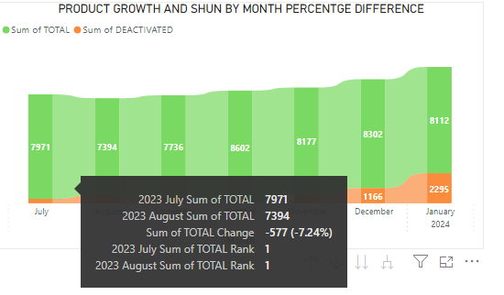
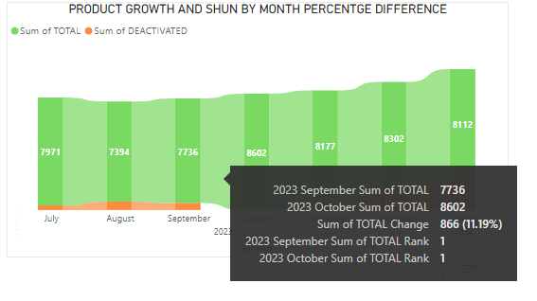
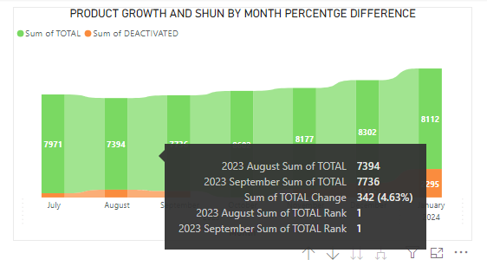
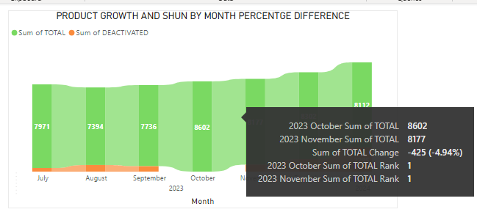
PRODUCT GROWTH BY MONTH

Slide 6
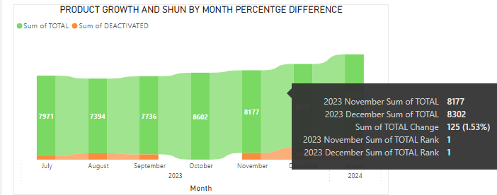
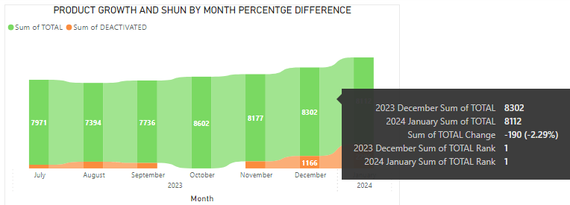
PRODUCT GROWTH BY MONTH
From the Chart above , Numbers of Deactivated Customers are analyzed for three month, and the result output shows that Hygiea has the Highest number of Deactivated customers from November till Date.

Slide 7
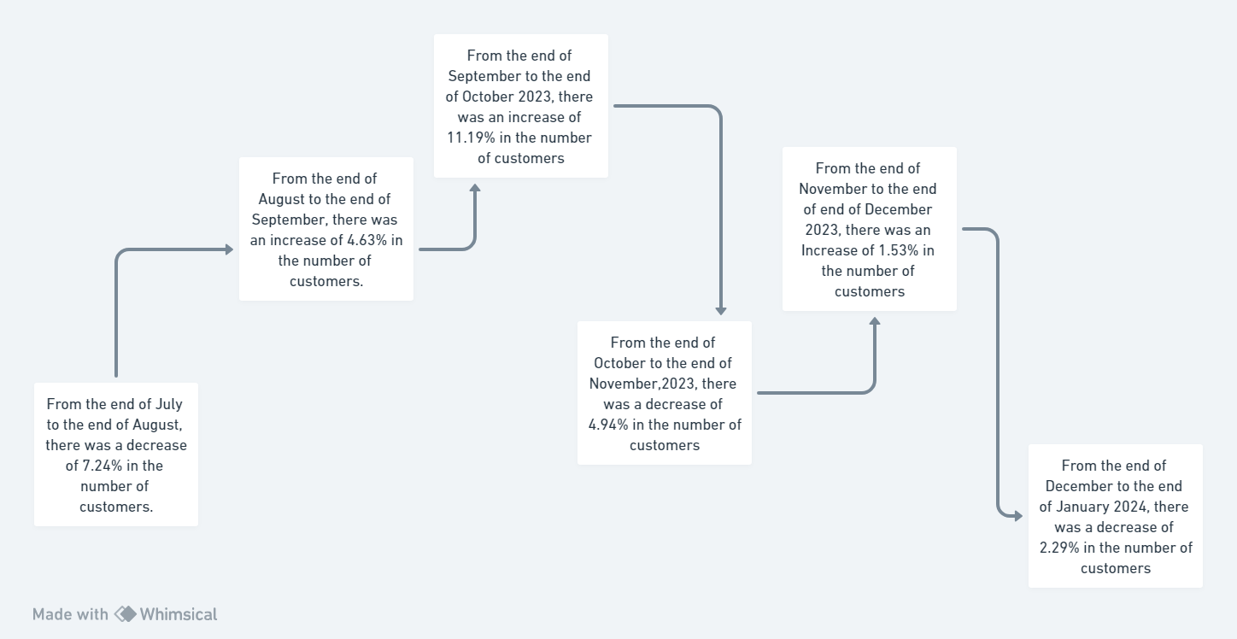
Product Growth Chart Flow
Showing the differences in the product growth monthly

Slide 8
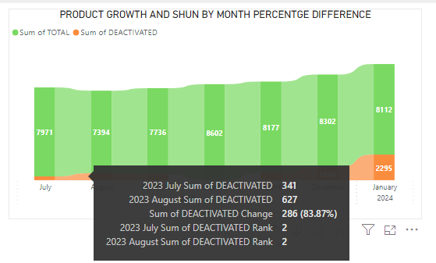
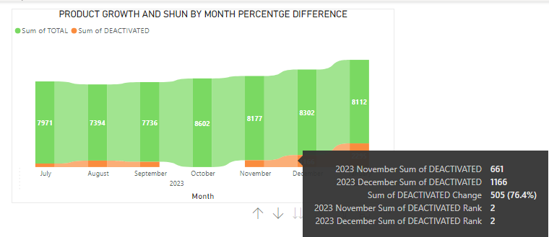
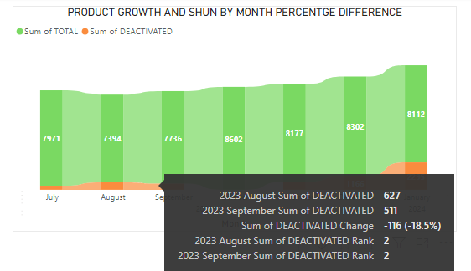
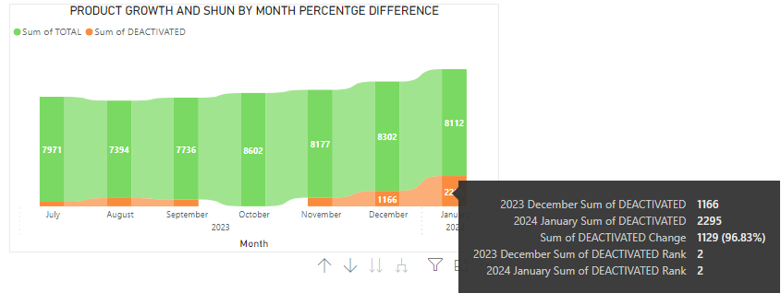
PRODUCT CHURN BY MONTH

Slide 9
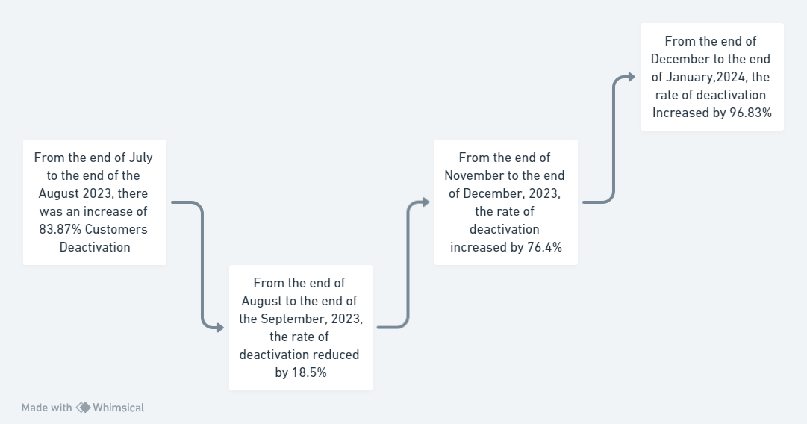
PRODUCT CHURN CHART FLOW
Showing the differences in the product shun monthly

Slide 10
Report Summary
From the Overall Report, January 2024 has 28.29% rate of deactivated customers and 71.71% Active Customers.
Hygiea has the highest rate of Deactivation between November, 2023 to January, 2024.
Between the end of December and the end of January 2024, there are 2.29% decrement in the number of customers.

Slide 11
Thank You!
@health_insured
@health_insured
in
@HealthInsured
HealthInsured
@
health_insured@sterling.ng
w
www.healthinsured.ng

